Slide 1
Bigdata Analytics
Presented by: Dr. Shweta Mongia

Slide 2
Table of Contents
What is bigdata
Bigdata sources
Need of Bigdata
Use-cases
Bigdata Technologies
Limitations of Existing System
Hadoop Definition

Slide 3
Cont..
Rackawareness
Mater-Slave Architecture
Write anatomy
Read anatomy
Processing in Hadoop
PIG
HIVE
Data Ingestion tools- SQOOP and FLUME
Other Hadoop distributors

Slide 4
What is Bigdata
Variety
Velocity
Volume

Slide 5
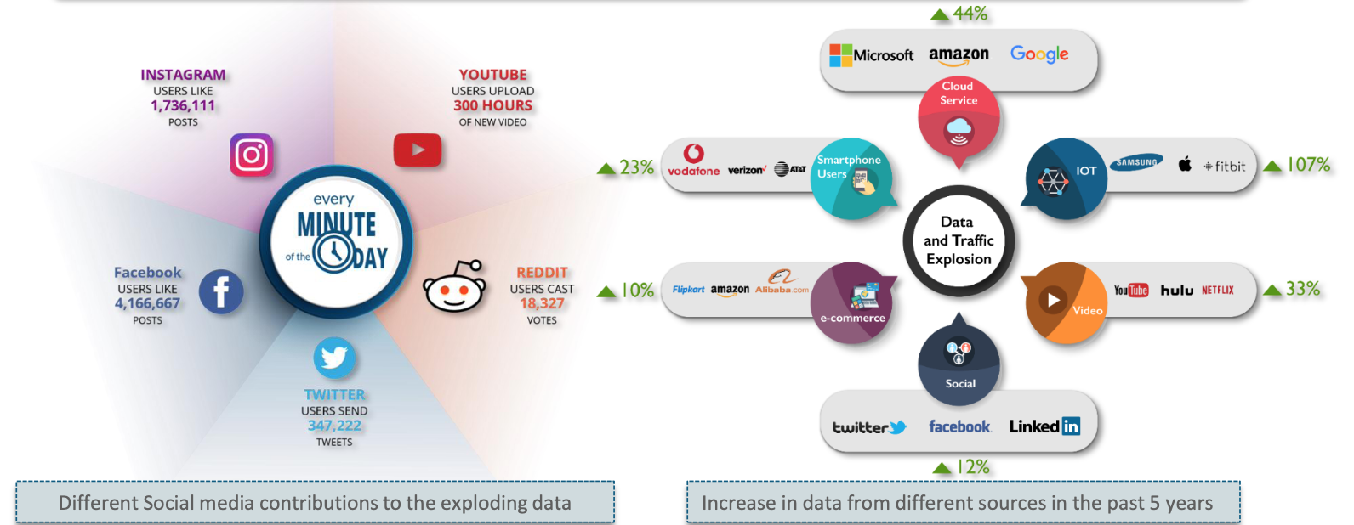
Bigdata is the term for a collection of datasets so large and complex that it becomes difficult to process in-hand database management tools or traditional data processing applications.
Reference- Edureka

Slide 6
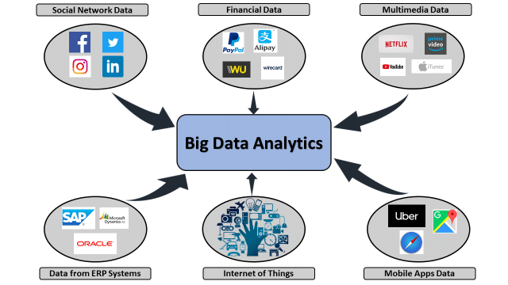
Bigdata Sources (Man + Machine)

Slide 7
Need of Bigdata
Use in public and private sector to:
Make faster and more accurate decisions
Make accurate predictions
Enhance business intelligence
Enable fraud detection
Reduce crime
Improve scientific research
Quicken analysis (Real time)
Weeks, days → minutes or seconds

Slide 8
Bigdata – Use cases
Telecom industry
Revenue Generation
Churn Prediction

Slide 9





Bigdata Technologies
Apache Hadoop
Apache Spark
Cassandra
Apache kafka
Apache Hive
Apache Pig
Apache Hadoop

Slide 10
Limitations of the Existing System
Why we are not able to process huge amount of data using existing system.
Why Hadoop is needed?

Slide 11
1. Problem : Vertical Scalability
Any system consist of?

Slide 12
Solution : Horizontal Scalability
How many machines can we add?

Slide 13
Virtual File System(HDFS)
Specification :?
Machine/ Client/ Node- 10GB
5 Node Hadoop Cluster
Do we have any physical machine which can handle 100 GB of data?

Slide 14
2. Huge amount of data getting transfer over the network
Database Server
High level overview of database: Any Database server consist of how many machines?
Instance Machine(Processing)
Data - 1TB
Speed – 100MB/Sec
How much time it will take to transfer the data?
(1024*1024)/100
1048576/100
10485.76Sec
174 Min
2.91 Hours
Now think for 1PB
Database Storage(.dbf)

Slide 15
Solution: Logic getting transfer over the network
Hadoop is achieving:
Divide and Conquer
Distributed Computing
Parallel Processing
B1
B2
B3
Student.txt (300MB)
B1-128MB
B2-128MB
B3-44MB

Slide 16
Hadoop Definition
software which is available free of cost-open source ( no license cost )
system which solves the problem of existing system
Vertical scalability- horizontal scalability
Instead of data, logic getting transfer over the network
Infinite scalability
Data is processed in distributed/ parallel manner
Quest: if you tell this definition to your manager, your manager will accept it or he/she will ask some more question?

Slide 17
Question raise on the reliable part of hadoop
Contradiction :
Replication- replication factor( by default-3)- configurable property
B1
B1
B1
B2
B2
Student.txt(300mb)
B1
B2
B3
B2
B3
B3
B3

Slide 18
Final Definition
Apache Hadoop is a framework that allows storage and processing of huge data sets across Hadoop cluster in a parallel and distributed fashion
Hadoop cluster is highly scalable and uses commodity hardware which are relatively cheaper
Hadoop is highly reliable system, it provides replication

Slide 19
Rack awareness

Slide 20
Out of 3 copies, 2 copies will go into the same rack and 3rd copy will go into the other rack..
Question : Why we are putting 2 copies into one rack? Why we are not putting all the copies into different racks to have more reliable system?

Slide 21
Rack awareness cont…
Intra-rack communication is far less costly than inter-rack communication.

Slide 22
Metadata
Question : If one file ‘student.txt’ is inserted by ‘X’ now ‘Y’ wants to read it. How it will be done?
Student.txt
300Mb
B1: 1,2,3
B2: 2,3,4
B3: 2,4,5
RAM
Master node
Namenode

Slide 23
Master- Slave Architecture
Heartbeat

Slide 24
Backup in Hadoop 2.0
Editlogs
Master Node (Namenode)
RAM
FSImage
Backupnode
Standby node
FSImage

Slide 25
Master- Slave Architecture (High Available)
Master
Namenode
Backup node
Standby node
Zookeeper- It ensures at any given point of time all the slave machines are reporting to only one master.
If active namenode fails- then without any downtime all slave machine communicate information to the standby node.
Slave 1
Datanode
Slave 2
Datanode
Slave 3
Datanode
Slave 4
Datanode

Slide 26
Federation
Question : Will you be able to store further file on cluster if RAM of master node is filled up?
Master Node
RAM
Metadata
Master Node
RAM
Metadata
+
1
2
3
4
+
+
+

Slide 27
Write Anatomy- successful
Hdfs dfs –put/ -copyFromLocal /localfilepath /HDFSfilepath
Machine/ Client
Student.txt (300 MB)
Metadata
B1- 2,9,6
B2: 19, 10, 4
B3-5, 11, 7

Slide 28
Write Anatomy- unsuccessful
Hdfs dfs –put/ -copyFromLocal /localfilepath /HDFSfilepath
Machine/ Client
Student.txt (300 MB)
Metadata
B1- 2,9,6
B2: 19, 10, 4
B3-5, 11, 7

Slide 29
Few questions
B1, B2, B3 are written Parallel or sequential
B1- P1, P2……P8 are written parallel or sequential
What will happen if further machine fails
By default replication factor is 3 what will happen to under replication then?
Why the name of block B1 changes to B11
What will happen to machine 2 and corrupted/half written block B1.

Slide 30
Read Anatomy
Hdfs dfs –cat /HDFSfilepath
Machine/ Client
Student.txt (300 MB)
Metadata
B1- 2,9,6
B2: 19, 10, 4
B3-5, 11, 7

Slide 31
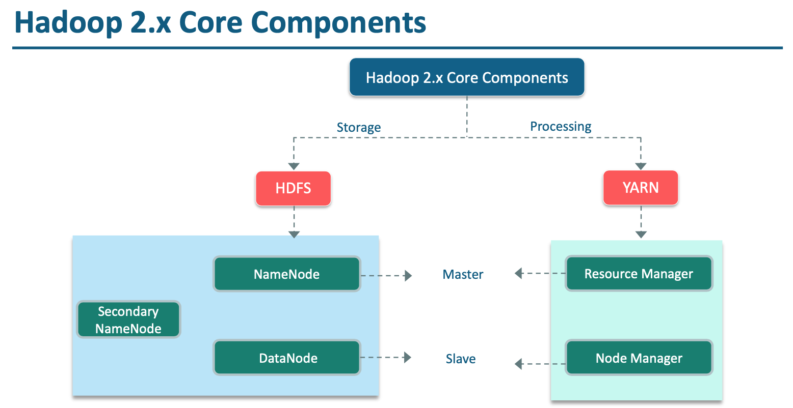
Reference- Edureka

Slide 32
Processing in Hadoop 1.0 (MAP REDUCE FRAMEWORK) Hadoop JAR Jarfilename classname /inputfilepath /outputfilepath
Client machine
Job tracker
Namenode
Metadata
B1- 2,9,6
B2: 19, 10, 4
B3-5, 11, 7
Jobid
TT
TT
TT
/Jobid
Jarfilename
Inputfilepath
Outputfilepath
B1
c
B2
B3
c
c
o
o
o
Sort and Shuffle phase
TT
o
c
Write Anatomy
HDFS Location

Slide 33
Data Locality Principle
B1
LO
B1
B1

Slide 34
What are the possible failure scenarios:
Mapper logic may fail
Reducer logic may fail
Task tracker may fail
Job tracker may fail

Slide 35
Processing in Hadoop 2.0 (MAP REDUCE FRAMEWORK) Hadoop Jar Jarfilename classname /inputfilepath /outputfilepath
B1- 2,9,6
B2: 19, 10, 4
B3-5, 11, 7
NM
AM

Slide 36
Anatomy of Map Reduce Program
Mapper
Input- Key, Value
Key: Line number
Value: complete line
Output: Key, Value
Sort and Shuffle
Input- Key, Value
Output: Key, list(values)
Reducer
Input- Key, list(Value)
Output: Key, values

Slide 37
Example: Word count program
Mapper
Reducer
This is Bigdata Analytics class.
This Bigdata class is good.
I am enjoying taking class.
This, 1
Is,1
Bigdata,1
Analytics,1
Class,1
SORT and Shuffle Phase
Am-{1}
Analytics-{1}
Bigdata-{1,1}
Class-{1,1,1}
Enjoying-{1}
Good-{1}
I-{1}
Is-{1,1}
Taking-{1}
This-{1,1}
Am-{1}
Analytics-{1}
Bigdata-{2}
Class-{3}
Enjoying-{1}
Good-{1}
I-{1}
Is-{2}
Taking-{1}
This-{2}
This-1,
Bigdata-1
Class-1
Is-1
Good-1
I-1
Am-1
Enjoying-1
Taking -1
Class-1

Slide 38
Hadoop Pig : Developed by Yahoo
Map Reduce
Powerful model for parallelism
Based on rigid procedural structure
Provides a good opportunity to parallelize algorithms
Pig
It is desirable to have a higher level declarative language.
Similar to SQL query where the user specifies the what and leaves the how to the underlying processing engine

Slide 39
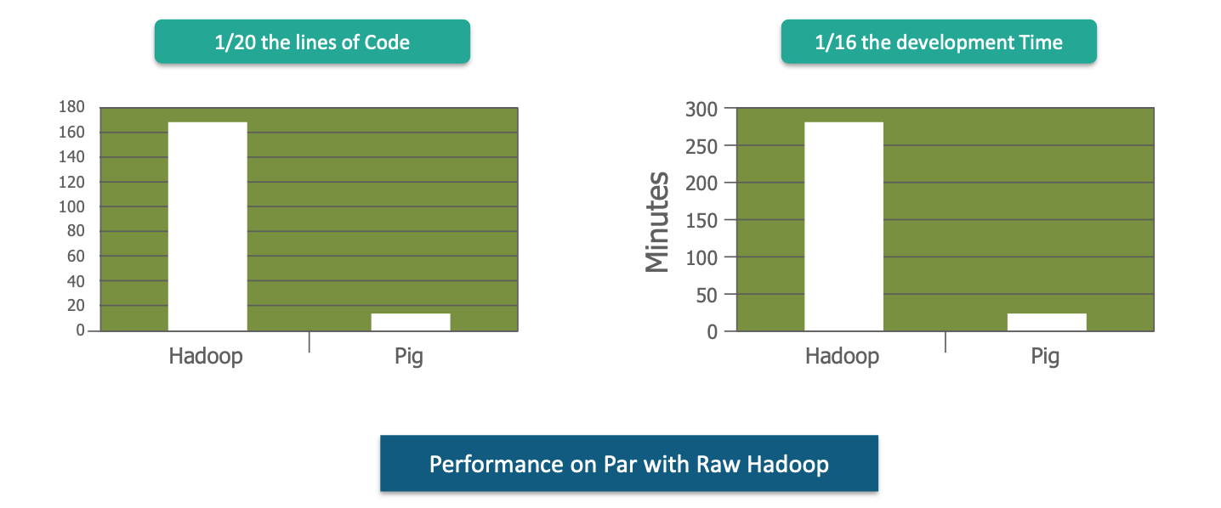
Hadoop Pig : Developed by Yahoo
What is the need of PIG when Map Reduce is there?
Source- Edureka

Slide 40
Why PIG
Java is not required
Can take any data- structure, unstructured, semi-structure
Simple and Easy to learn, read and write
Extensible by UDF(Python, JAVA, Javascript)
Open source and actively supported by a community of developers

Slide 41
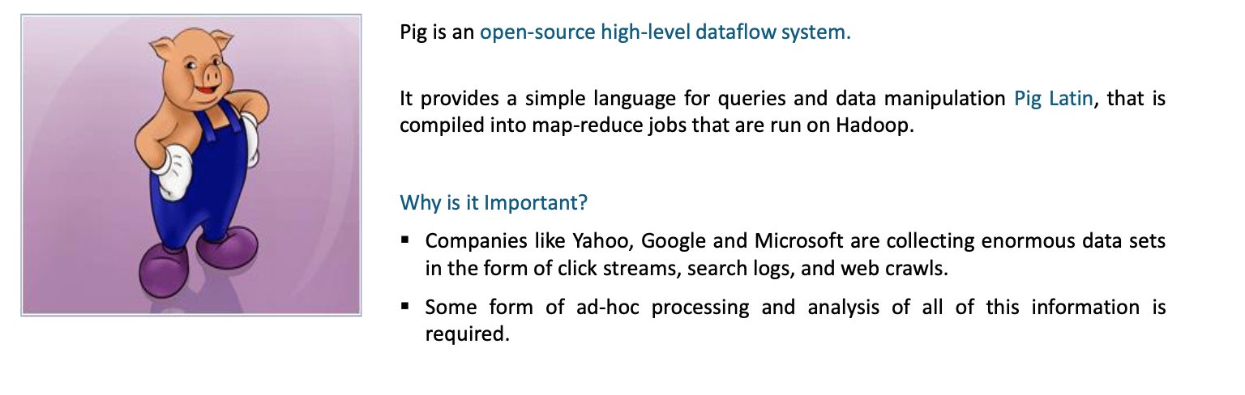
PIG
Source- Edureka

Slide 42
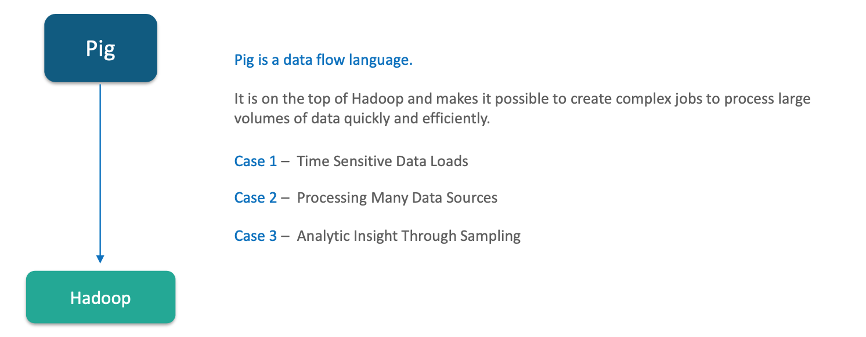
Where to use PIG
Source- Edureka

Slide 43
Use cases of PIG
Data Processing for search platforms
Support for Ad Hoc queries across large datasets.
Quick prototyping of algorithms for processing large datasets
Processing of web logs.

Slide 44
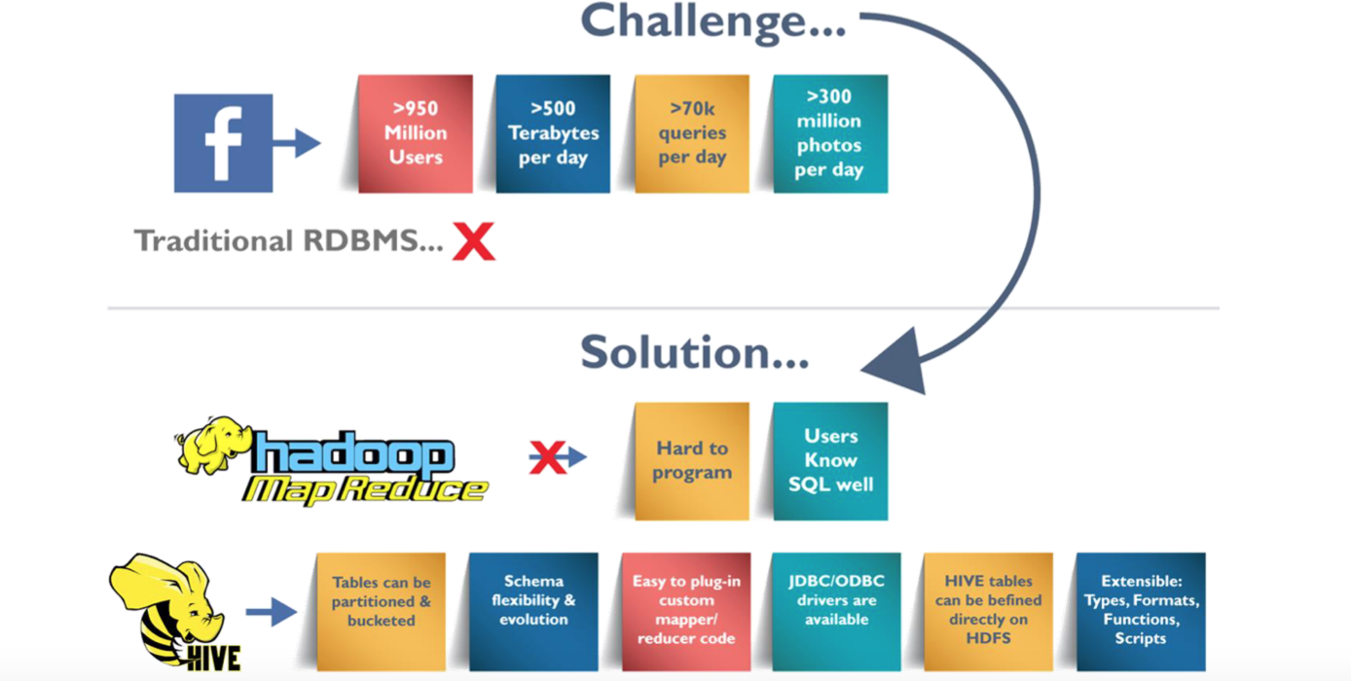
HIVE: Developed by Facebook
Source- Edureka

Slide 45
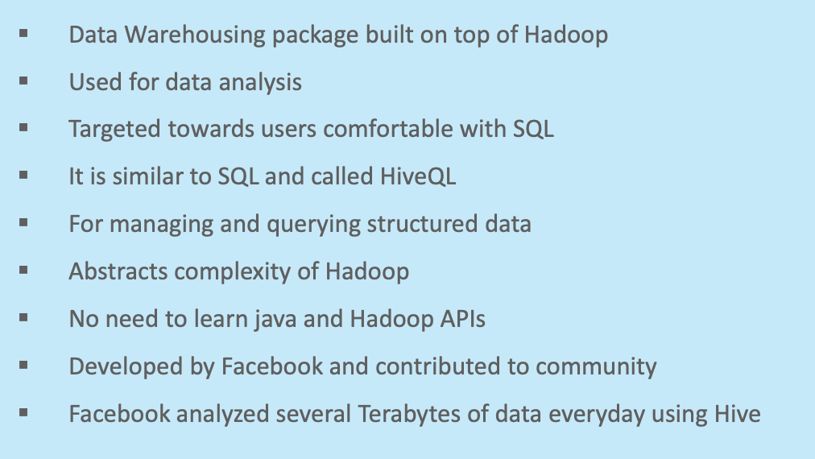
What is Hive?
Source- Edureka

Slide 46
HIVE Applications
Log Processing
Document indexing
Predictive modelling, Hypothesis testing
Data Mining
Business Intelligence

Slide 47
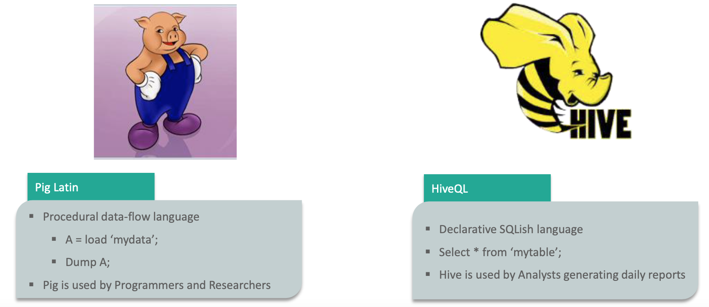
Question: Why we need HIVE when PIG is there?

Slide 48
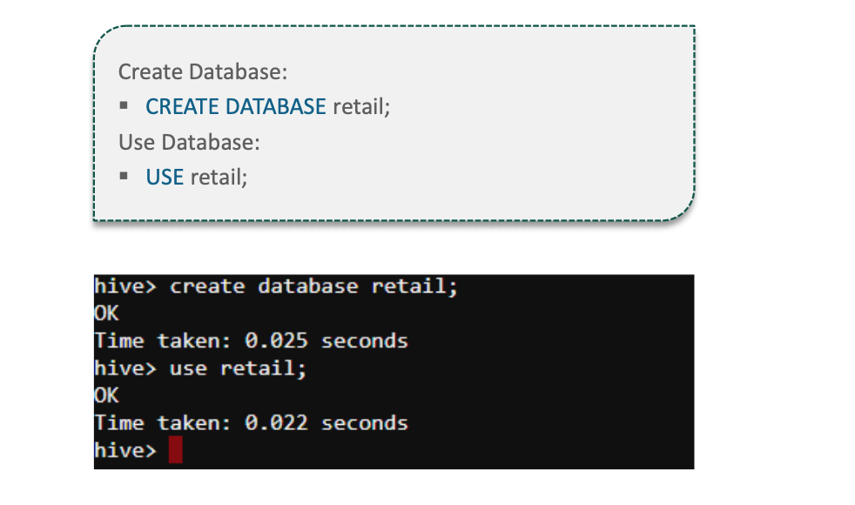

Slide 49
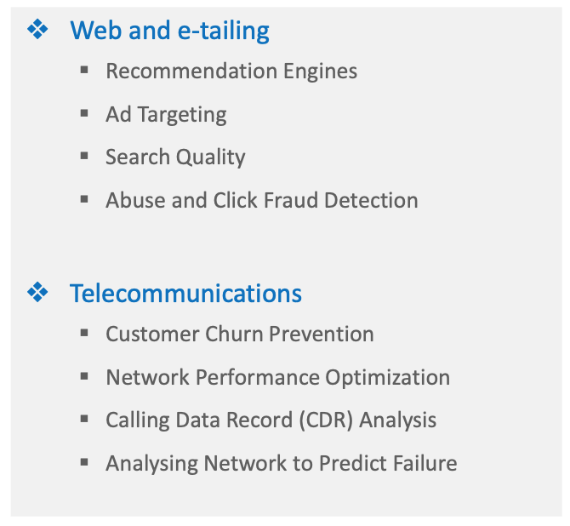
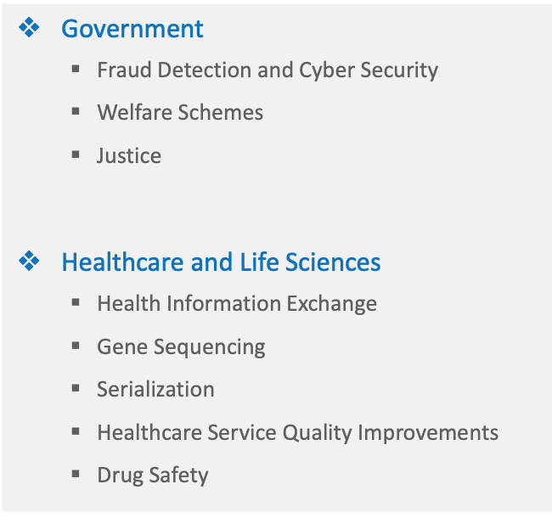
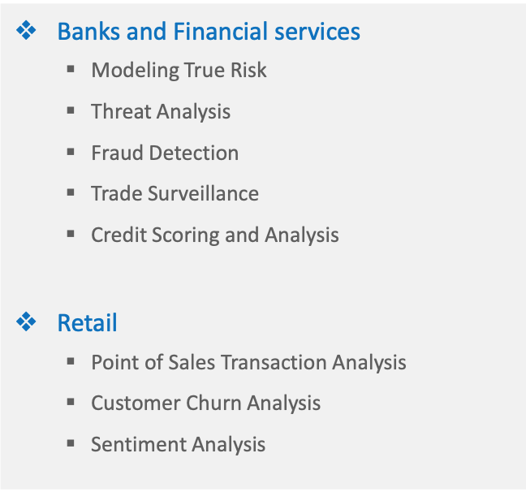
BIGDATA Use cases

Slide 50
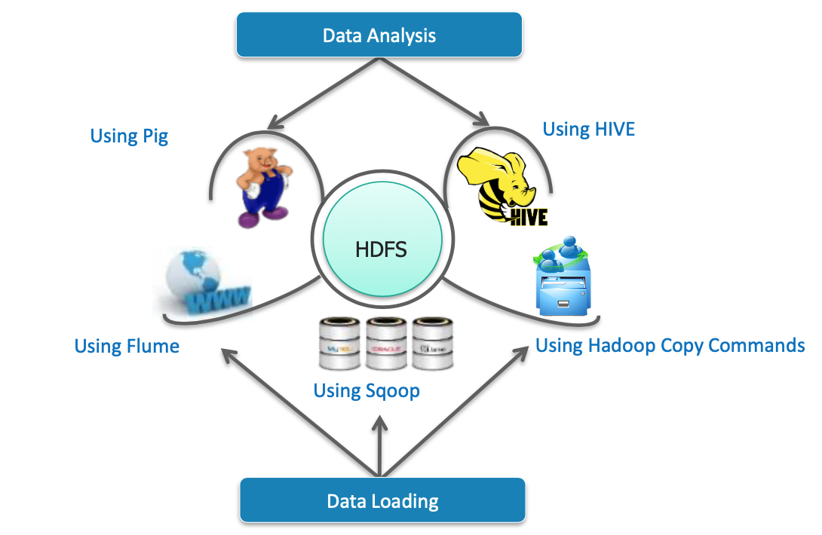
Data Flow: SQOOP, FLUME
Source- Edureka

Slide 51
Sqoop : Data ingestion tool RDBMS ←→ HDFS
sqoop import --connect jdbc:mysql://localhost/studentdb --table student --username Shweta --password Shweta --target-dir /sqoop_output --m 1
sqoop export --connect jdbc:mysql://localhost/studentdb --table class --username Shweta --password Shweta --export-dir /sqoop_output --m 1

Slide 52
Flume: Data ingestion tool
Streaming data source: Any data which is generating data on continuous basis
Streaming Data source: Twitter, Instagram, Netflix, API
HDFS
FLUME
Flume agent: is the configuration of three important components:
Source: Any source which is generating data on continuous manner
Memory Channel: Captures the data on real basis
Sink: HDFS

Slide 53
Benefits and Barriers of Bigdata Analytics
Benefits:
Anything involving customers could benefit from bigdata Analytics
Business intelligence in general can benefit from bigdata analytics
Specific analytics applications are likely beneficiaries of bigdata analytics
Barriers:
Inadequate staffing and skills are the leading barriers to bigdata analytics
A lack of business support can hinder a bigdata analytics program
Problems with database software can be a barriers to bigdata analytics

Slide 54
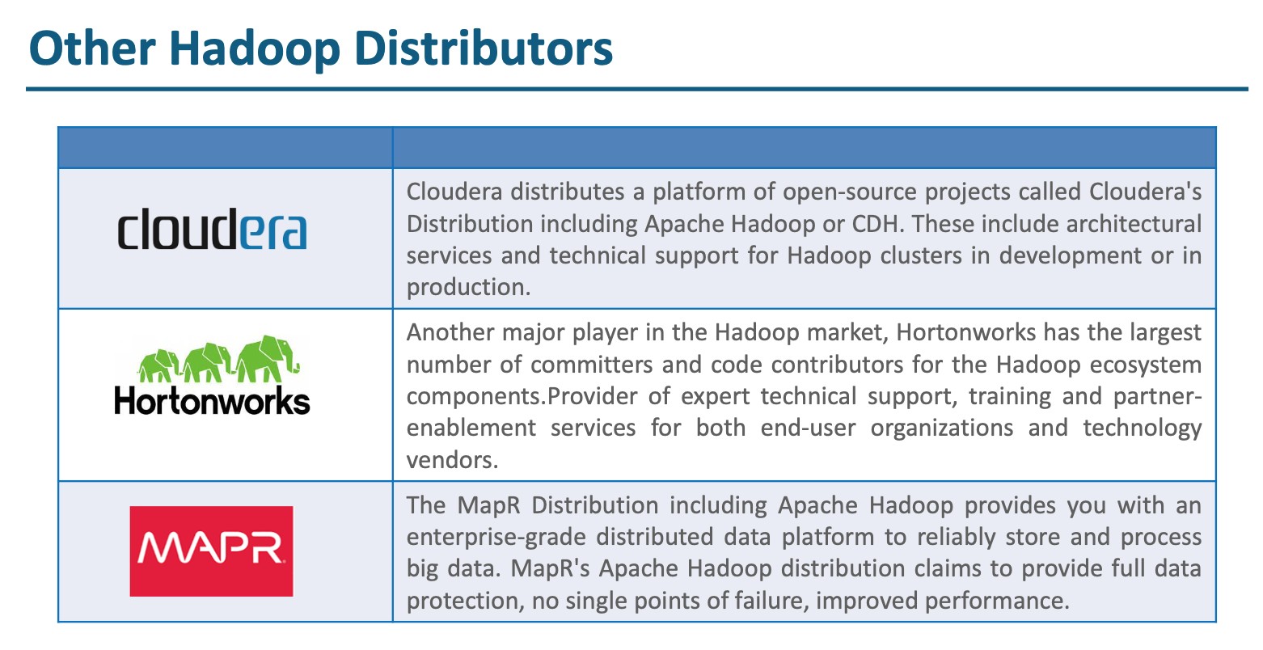

Slide 55


